Slide 1
24-1 DATA TRAFFIC
The main focus of congestion control and quality of service is data traffic. In congestion control we try to avoid traffic congestion. In quality of service, we try to create an appropriate environment for the traffic. So, before talking about congestion control and quality of service, we discuss the data traffic itself.

Slide 2
What is congestion?
A state occurring in network layer when the message traffic is so heavy that it slows down network response time.
Effects of Congestion:
Notes:
Effects of Congestion
As delay increases, performance decreases.
If delay increases, retransmission occurs, making situation worse.

Slide 3
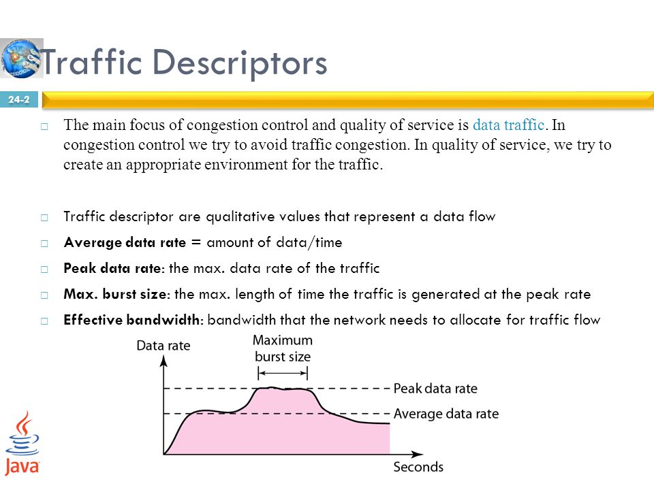

Figure 24.1 Traffic descriptors

Slide 4

Figure 24.2 Three traffic profiles

Slide 5
24-2 CONGESTION
Congestion in a network may occur if the load on the network—the number of packets sent to the network—is greater than the capacity of the network—the number of packets a network can handle. Congestion control refers to the mechanisms and techniques to control the congestion and keep the load below the capacity.

Slide 6

Figure 24.3 Queues in a router

Slide 7

Network Performance: Delay and throughput as functions of load
Notes:
The delays, here, means the time for which the processing of a particular packet takes place.
In data transmission, network throughput is the amount of data moved successfully from one place to another in a given time period, and typically measured in bits per second (bps), as in megabits per second (Mbps) or gigabits per second (Gbps).

Slide 8
24-3 CONGESTION CONTROL
Congestion control refers to techniques and mechanisms that can either prevent congestion, before it happens, or remove congestion, after it has happened. In general, we can divide congestion control mechanisms into two broad categories: open-loop congestion control (prevention) and closed-loop congestion control (removal).
Topics discussed in this section:
Open-Loop Congestion Control
Closed-Loop Congestion Control

Slide 9

Figure 24.5 Congestion control categories

Slide 10
Retransmission Policy
a. The sender retransmits a packet, if it feels that the packet it has sent is lost or corrupted.
b. However retransmission in general may increase the congestion in the network. But we need to implement good retransmission policy to prevent congestion.
c. The retransmission policy and the retransmission timers need to be designed to optimize efficiency and at the same time prevent the congestion.
When to retransmit
  Lost Frame
  Lost Ack
  Damaged Frame
  After Timer expiration
  timer value too small– more retransmissions
  timer value too large– delay in response to lost segment.

Slide 11
Window policy
The type of window at the sender’s side may also affect the congestion. Several packets in the Go-back-n window are re-sent, although some packets may be received successfully at the receiver side. This duplication may increase the congestion in the network and make it worse.
Therefore, Selective repeat window should be adopted as it sends the specific packet that may have been lost.
What will be maximum size of window- in case of sliding window protocol
  Either you implement
  - Go-Back N ARQ
  - Selective Repeat ARQ

Slide 12
Key | Go-Back-N | Selective Repeat
Definition | In Go-Back-N, if a sent frame is found suspected or damaged, then all the frames are retransmitted till the last packet. | In Selective Repeat, only the suspected or damaged frames are retransmitted.
Sender Window Size | Sender Window is of size N. | Sender Window size is same as N.
Receiver Window Size | Receiver Window Size is 1. | Receiver Window Size is N.
Complexity | Go-Back-N is easier to implement. | In Selective Repeat, receiver window needs to sort the frames.
Efficiency | Efficiency of Go-Back-N = N / (1 + 2a), where "a" is ratio of propagation delay vs. transmission delay and "N" is the number of packets sent. | Efficiency of Selective Repeat = N / (1 + 2a).
Acknowledgement | Acknowledgement type is cumulative. | Acknowledgement type is individual.
Sorting | Neither the sender nor the recipient requires sorting. | To sort the frames on the receiver side, sorting is needed.
Out-of-order Packets | Out-of-Order packets are rejected, and the entire window is re-transmitted. | Out-of-Order packets are accepted in the selective Repeat protocol.
Minimum Sequence Number | The Minimum Sequence Number in the Go-Back-N protocol is N+1, where "N" is the number of packets sent. | The Minimum Sequence Number in the Selective Repeat protocol is 2N, where "N" is the number of packets transmitted.

Slide 13
Acknowledgement Policy
a. The acknowledgement policy imposed by the receiver may also affect congestion.
b. If the receiver does not acknowledge every packet it receives it may slow down the sender and help prevent congestion.
c. Acknowledgments also add to the traffic load on the network. Thus, by sending fewer acknowledgements we can reduce load on the network.
d. To implement it, several approaches can be used:
A receiver may send an acknowledgement only if it has a packet to be sent.
A receiver may send an acknowledgement when a timer expires.
A receiver may also decide to acknowledge only N packets at a time.
Selective Ack
Cumlative Ack
Notes:
Cumulative acknowledgement is a method wherein the receiver sends a unmarried acknowledgement in reaction to a finite range of frames obtained.
Selective acknowledgement means computer systems talk the identical manner with a TCP acknowledgement alternative.

Slide 14
Discarding policy
A good discarding policy adopted by the routers is that the routers may prevent congestion and at the same time partially discard the corrupted or less sensitive packages and also be able to maintain the quality of a message.
In case of audio file transmission, routers can discard less sensitive packets to prevent congestion and also maintain the quality of the audio file.
In case of congestion
  Which packet to discard
    Low priority
    Newer Packet
    Discard the packet which is NOT nearest to destination
    When to discard
      Make sure , you are NOT discarding those packets which are just about to enter the destination’s network.

Slide 15
Admission Policy
In admission policy a mechanism should be used to prevent congestion. Switches in a flow should first check the resource requirement of a network flow before transmitting it further. If there is a chance of a congestion or there is a congestion in the network, router should deny establishing a virtual network connection to prevent further congestion.
If there are insufficient resources to handle the transmission, then do not accept any more packets from sender.
A router can deny establishing a virtual circuit connection if there is a congestion.

Slide 16
Solutions to Open Loop Congestion
Selective repeat window is better
Should send cumulative acknowledgement
Higher priority packets should not be discard

Slide 17
Closed Loop Congestion Control
Backpressure
Choke packet
Implicit Signaling
Explicit Signaling
Notes:
Backpressure refers to the buildup of data at an I/O switch when buffers are full and not able to receive additional data.
A choke packet is a packet sent by a node to the source to inform it of congestion.
In implicit signaling, there is no communication between the congested nodes and the source.
In explicit signaling, if a node experiences congestion it can explicitly sends a packet to the source or destination to inform about congestion.

Slide 18

Figure 24.6 Backpressure method for alleviating congestion
Backpressure is a technique in which a congested node stops receiving packets from upstream node. This may cause the upstream node or nodes to become congested and reject receiving data from above nodes. Backpressure is a node-to-node congestion control technique that propagate in the opposite direction of data flow. The backpressure technique can be applied only to virtual circuit where each node has information of its above upstream node.

Slide 19

Figure 24.7 Choke packet
Choke packet is a packet sent by a node to the source to inform it of congestion. Each router monitors its resources and the utilization at each of its output lines. Whenever the resource utilization exceeds the threshold value which is set by the administrator, the router directly sends a choke packet to the source giving it a feedback to reduce the traffic. The intermediate nodes through which the packets has traveled are not warned about congestion.
Notes:
Thresholds are baselines established to monitor data collection. If collected data goes beyond the Threshold value, it indicates that the collected value is not a recommended value which may decline network performance.

Slide 20
Congestion leads to –
discard of segments
transmission delay increase
Implicit Signaling- by symptom source will aware about congestion in network. No communication is send to source from congested node. For example, through delayed acknowledgments.
Explicit signal- network alerts sender or destination to slow down the rate of transmission by sending signal that is included in packet that carry data. That is why its different from choke packet.
Backward signaling- warning source (opposite direction to congestion) and take appropriate congestion corrective measures
Forward signaling- warning destination (same direction to congestion) and take appropriate congestion avoidance measures. Such as receiver can slow down the acknowledgment

Slide 21
Quality of service (QoS)
To provide good quality of service is to build a network with enough capacity for whatever traffic will be thrown at it. The name for this solution is over-provisioning.
Quality of service mechanisms let a network
with less capacity meet application requirements just as well at a lower cost.

Slide 22
Flow Characteristics
Reliability
Delay
Jitter– variation in delay
Bandwidth

Slide 23
TECHNIQUES TO IMPROVE QoS
Scheduling
  FIFO Queuing
  Priority Queuing
  Weighted Fair Queuing
Traffic Shaping
  Leaky Bucket
  Token Bucket
Resource Reservation
Admission Control

Slide 24

Scheduling : FIFO queue

Slide 25

Scheduling : Priority queuing

Slide 26
Priority queuing have problem of starvation
Notes:
When a process is waiting for a resource that is repeatedly given to some other process, it is known as starvation.
starvation is when a process keeps waiting for a resource that is being given to other processes.

Slide 27

Scheduling : Weighted fair queuing
Notes:
Weighted fair queueing (WFQ) is a method of automatically smoothing out the flow of data in packet-switched communication networks by sorting packets to minimize the average latency and prevent exaggerated discrepancies between the transmission efficiency afforded to narrowband versus broadband signals.

Slide 28
Traffic Shaping
Traffic shaping is a technique for regulating/ controling the average rate and burst-ness of a flow of data that enters the network.
The goal is to allow applications to transmit a wide variety of traffic that suits their needs, including some bursts.
SLA (Service Level Agreement)
Notes:
SLA stands for Service-Level Agreement, which is a contractual agreement between a customer and a service provider that outlines what services will be provided and defines the acceptable range of performance and availability of those services.
Service-level agreements (SLAs) also indicate the costs and penalties that will be incurred when performance and availability fall below acceptable levels. SLAs are typically used in contracts with telecommunications service providers who provide WAN links for wide area networks (WANs).

Slide 29
Traffic Policing
Traffic shaping reduces congestion and thus helps the network live up to its promise.
There is also the issue of how the provider can tell if the customer is following the agreement and what to do if the customer is not.
Packets in excess of the agreed pattern might be dropped by the network, or they might be marked as having lower priority.
Monitoring a traffic flow is called traffic policing.

Slide 30
There are 2 types of traffic shaping algorithms
Leaky Bucket
Token Bucket

Slide 31

Traffic Shaping : Leaky bucket
Notes:
Suppose we have a bucket in which we are pouring water, at random points in time, but we have to get water at a fixed rate, to achieve this we will make a hole at the bottom of the bucket. This will ensure that the water coming out is at some fixed rate, and also if the bucket gets full, then we will stop pouring water into it.
The input rate can vary, but the output rate remains constant. Similarly, in networking, a technique called leaky bucket can smooth out bursty traffic. Bursty chunks are stored in the bucket and sent out at an average rate.

Slide 32
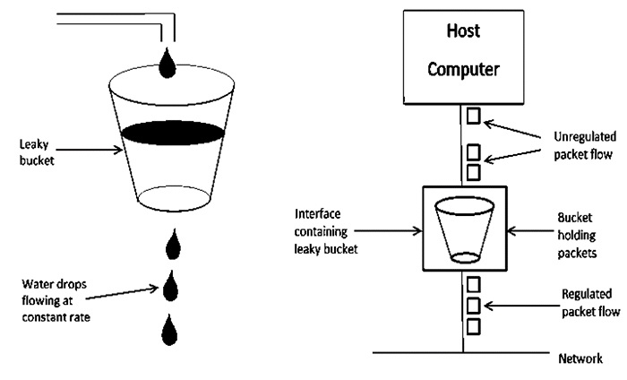

Slide 33
Leaky Bucket Algorithm mainly controls the total amount and the rate of the traffic sent to the network.
Step 1 − Let us imagine a bucket with a small hole at the bottom where the rate at which water is poured into the bucket is not constant and can vary but it leaks from the bucket at a constant rate.
Step 2 − So (up to water is present in the bucket), the rate at which the water leaks does not depend on the rate at which the water is input to the bucket.
Step 3 − If the bucket is full, additional water that enters into the bucket that spills over the sides and is lost.
Step 4 − Thus the same concept applied to packets in the network. Consider that data is coming from the source at variable speeds. Suppose that a source sends data at 10 Mbps for 4 seconds. Then there is no data for 3 seconds. The source again transmits data at a rate of 8 Mbps for 2 seconds. Thus, in a time span of 8 seconds, 68 Mb data has been transmitted.
That’s why if a leaky bucket algorithm is used, the data flow would be 8 Mbps for 9 seconds. Thus, the constant flow is maintained.

Slide 34

Traffic Shaping : Leaky bucket implementation

Slide 35

Note
A leaky bucket algorithm shapes bursty traffic into fixed-rate traffic by averaging the data rate. It may drop the packets if the bucket is full.

Slide 36
Note
The token bucket allows bursty traffic at a regulated maximum rate.

Slide 37
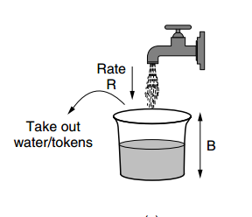
Notes:
Token bucket algorithm is one of the techniques for congestion control algorithms. When too many packets are present in the network it causes packet delay and loss of packet which degrades the performance of the system. This situation is called congestion.
The network layer and transport layer share the responsibility for handling congestions. One of the most effective ways to control congestion is trying to reduce the load that transport layer is placing on the network. To maintain this network and transport layers have to work together.

Slide 38

Figure 24.21 Token bucket

Slide 39
Leaky Bucket | Token Bucket
When the host has to send a packet , packet is thrown in bucket. | In this, the bucket holds tokens generated at regular intervals of time.
Bucket leaks at constant rate | Bucket has maximum capacity.
Bursty traffic is converted into uniform traffic by leaky bucket. | If there is a ready packet , a token is removed from Bucket and packet is send.
In practice bucket is a finite queue outputs at finite rate | If there is no token in the bucket, then the packet cannot be sent.

